Slide 1



Yocto Project Developer Day
Intro to Yocto Project
Creating a Custom Embedded Linux Distribution for Any Embedded Device Using the Yocto Project
Behan Webster
Jan-Simon Möller
The Linux Foundation
Oct 10, 2016
‹#›

Slide 2
Yocto Project Dev Day Wifi information
If you want to connect to the Internet:
SSID: lfevents
Password: linux1991

Slide 3
The URL for this presentation
http://bit.ly/2dt6ggP

Slide 4
Yocto Project Overview
Collection of tools and methods enabling
Rapid evaluation of embedded Linux on many popular off-the-shelf boards
Easy customization of distribution characteristics
Supports x86, ARM, MIPS, Power
Based on technology from the OpenEmbedded Project
Layer architecture allows for easy re-use of code
other layers
meta-yocto-bsp
meta-poky
meta (oe-core)
‹#›

Slide 5
What is the Yocto Project?
Umbrella organization under Linux Foundation
Backed by many companies interested in making Embedded Linux easier for the industry
Co-maintains OpenEmbedded Core and other tools (including opkg)
‹#›

Slide 6
Yocto Project Governance
Organized under the Linux Foundation
Split governance model
Technical Leadership Team
Advisory Board made up of participating organizations
‹#›

Slide 7
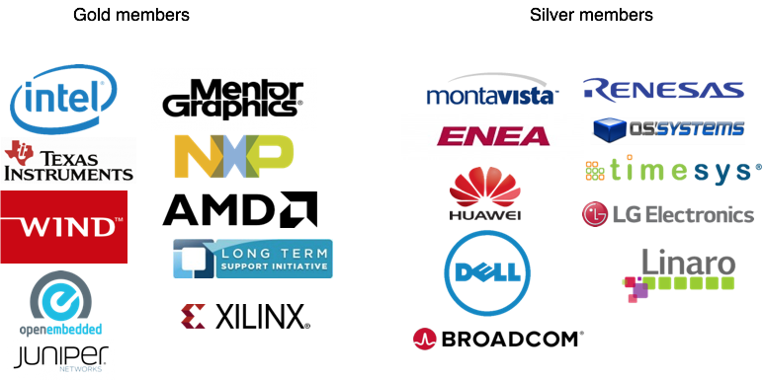
Yocto Project Member Organizations

Slide 8
Yocto Project Overview
YP builds packages - then uses these packages to build bootable images
Supports use of popular package formats including:
rpm, deb, ipk
Releases on a 6-month cadence
Latest (stable) kernel, toolchain and packages, documentation
App Development Tools including Eclipse plugin, SDK, toaster
‹#›

Slide 9
Yocto Project Release Versions
Name | Revision | Poky | Release Date
Bernard | 1.0 | 5.0 | Apr 5, 2011
Edison | 1.1 | 6.0 | Oct 17, 2011
Denzil | 1.2 | 7.0 | Apr 30, 2012
Danny | 1.3 | 8.0 | Oct 24, 2012
Dylan | 1.4 | 9.0 | Apr 26, 2013
Dora | 1.5 | 10.0 | Oct 19, 2013
Daisy | 1.6 | 11.0 | Apr 24, 2014
Dizzy | 1.7 | 12.0 | Oct 31, 2014
Fido | 1.8 | 13.0 | April 22, 2015
Jethro | 2.0 | 14.0 | Oct 31, 2015
Krogoth | 2.1 | 15.0 | April 29, 2016
Morty | 2.2 | 16.0 | Oct 28, 2016
‹#›

Slide 10
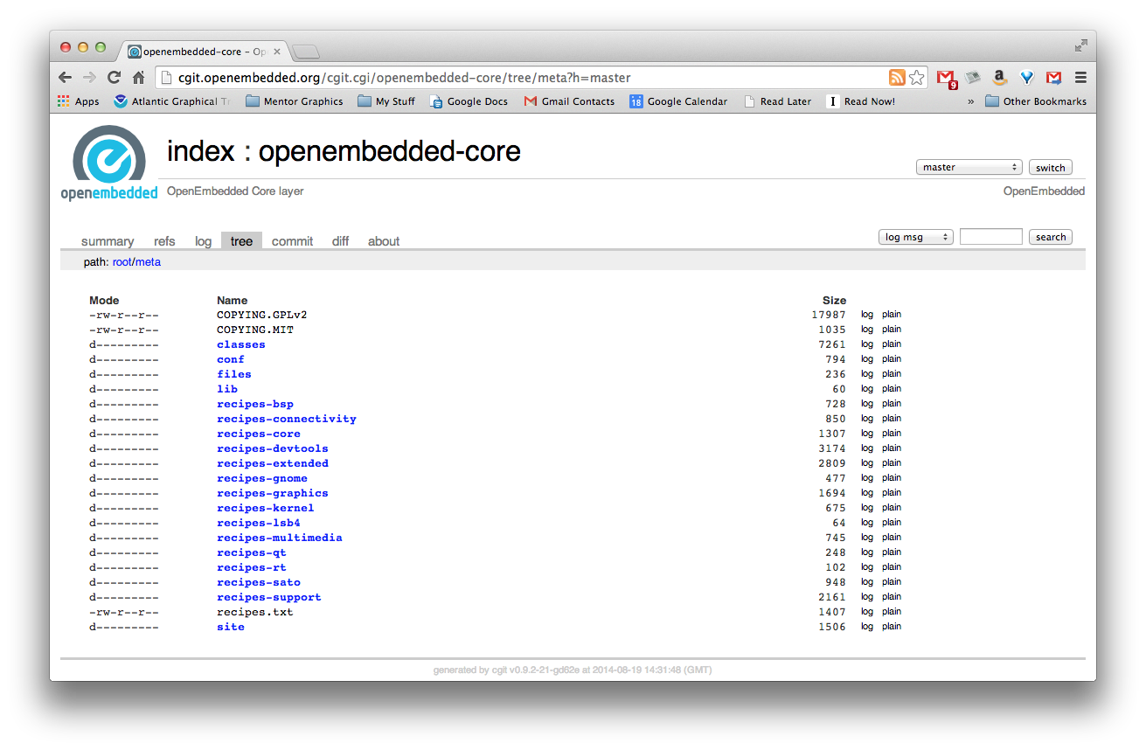
Yocto is based on OpenEmbedded-core
Metadata describing approximately 1600 "core" recipes used for building boot images. Includes support for graphics, Qt, networking, kernel recipes, tools, much more.
‹#›

Slide 11
Intro to OpenEmbedded
The OpenEmbedded Project co-maintains OE-core build system:
bitbake build tool and scripts
Metadata and configuration
Provides a central point for new metadata
(see the OE Layer index)
‹#›
Notes:
Concepts
© 2014 Mentor Graphics Corporation
Mentor Embedded Linux Training
‹#›

Slide 12
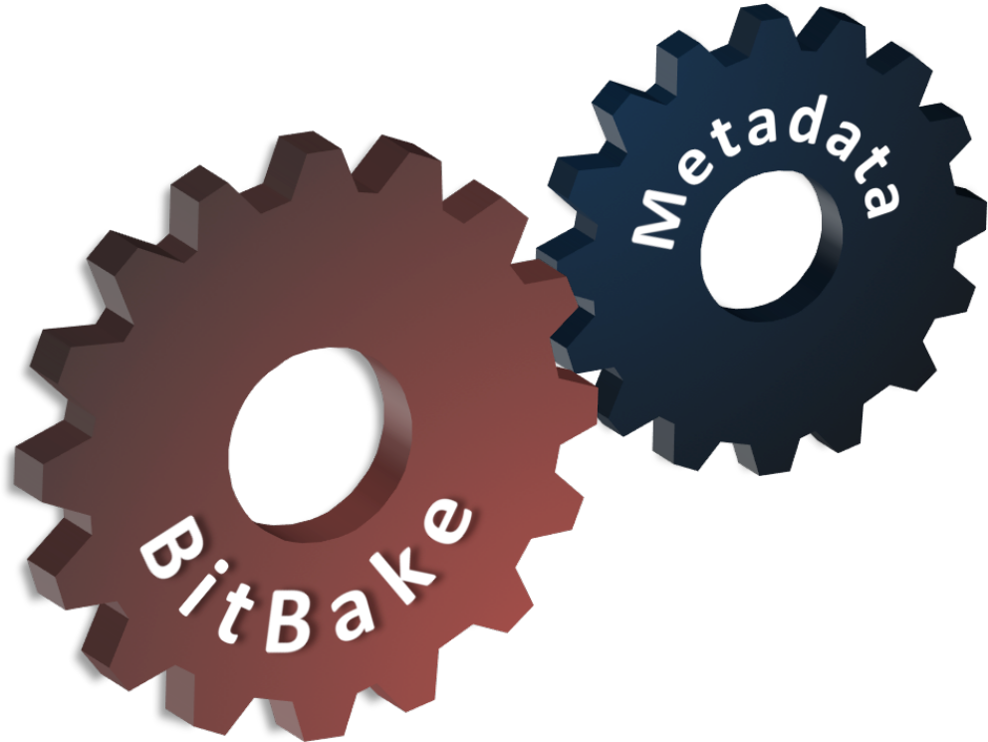
What is Bitbake?
Bitbake
Powerful and flexible build engine (Python)
Reads metadata
Determines dependencies
Schedules tasks
Metadata – a structured collection of "recipes" which tell BitBake what to build, organized in layers
‹#›
Notes:
Concepts
© 2014 Mentor Graphics Corporation
Mentor Embedded Linux Training
‹#›

Slide 13
OK, so what is Poky?
Poky is a reference distribution
Poky has its own git repo
git clone git://git.yoctoproject.org/poky
Primary Poky layers
oe-core (poky/meta)
meta-poky (poky/meta-poky)
meta-yocto-bsp
Poky is the starting point for building things with the Yocto Project
Other layers
meta-yocto-bsp
meta-poky
meta (oe-core)
‹#›

Slide 14
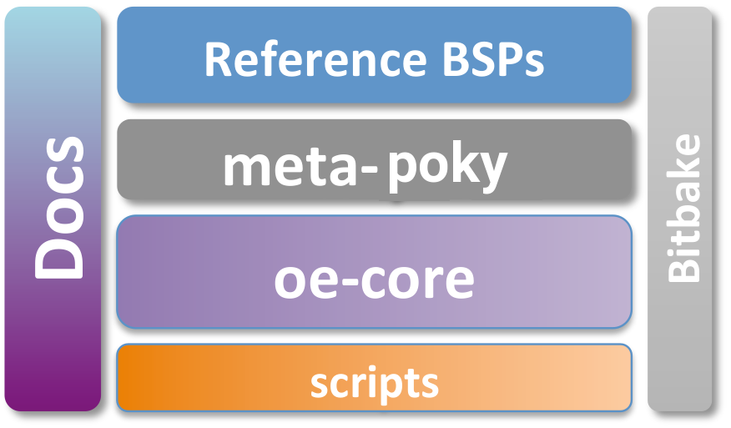
Poky in Detail
Contains core components
Bitbake tool: A python-based build engine
Build scripts (infrastructure)
Foundation package recipes (oe-core)
meta-poky (Contains distribution policy)
Reference BSPs
Yocto Project documentation

Slide 15
Putting It All Together
Yocto Project is a large collaboration
OpenEmbedded is the build system
Bitbake is the built tool
Poky is the Yocto Project's reference distribution
Poky contains a version of bitbake and oe-core from which you can start your project
‹#›

Slide 16
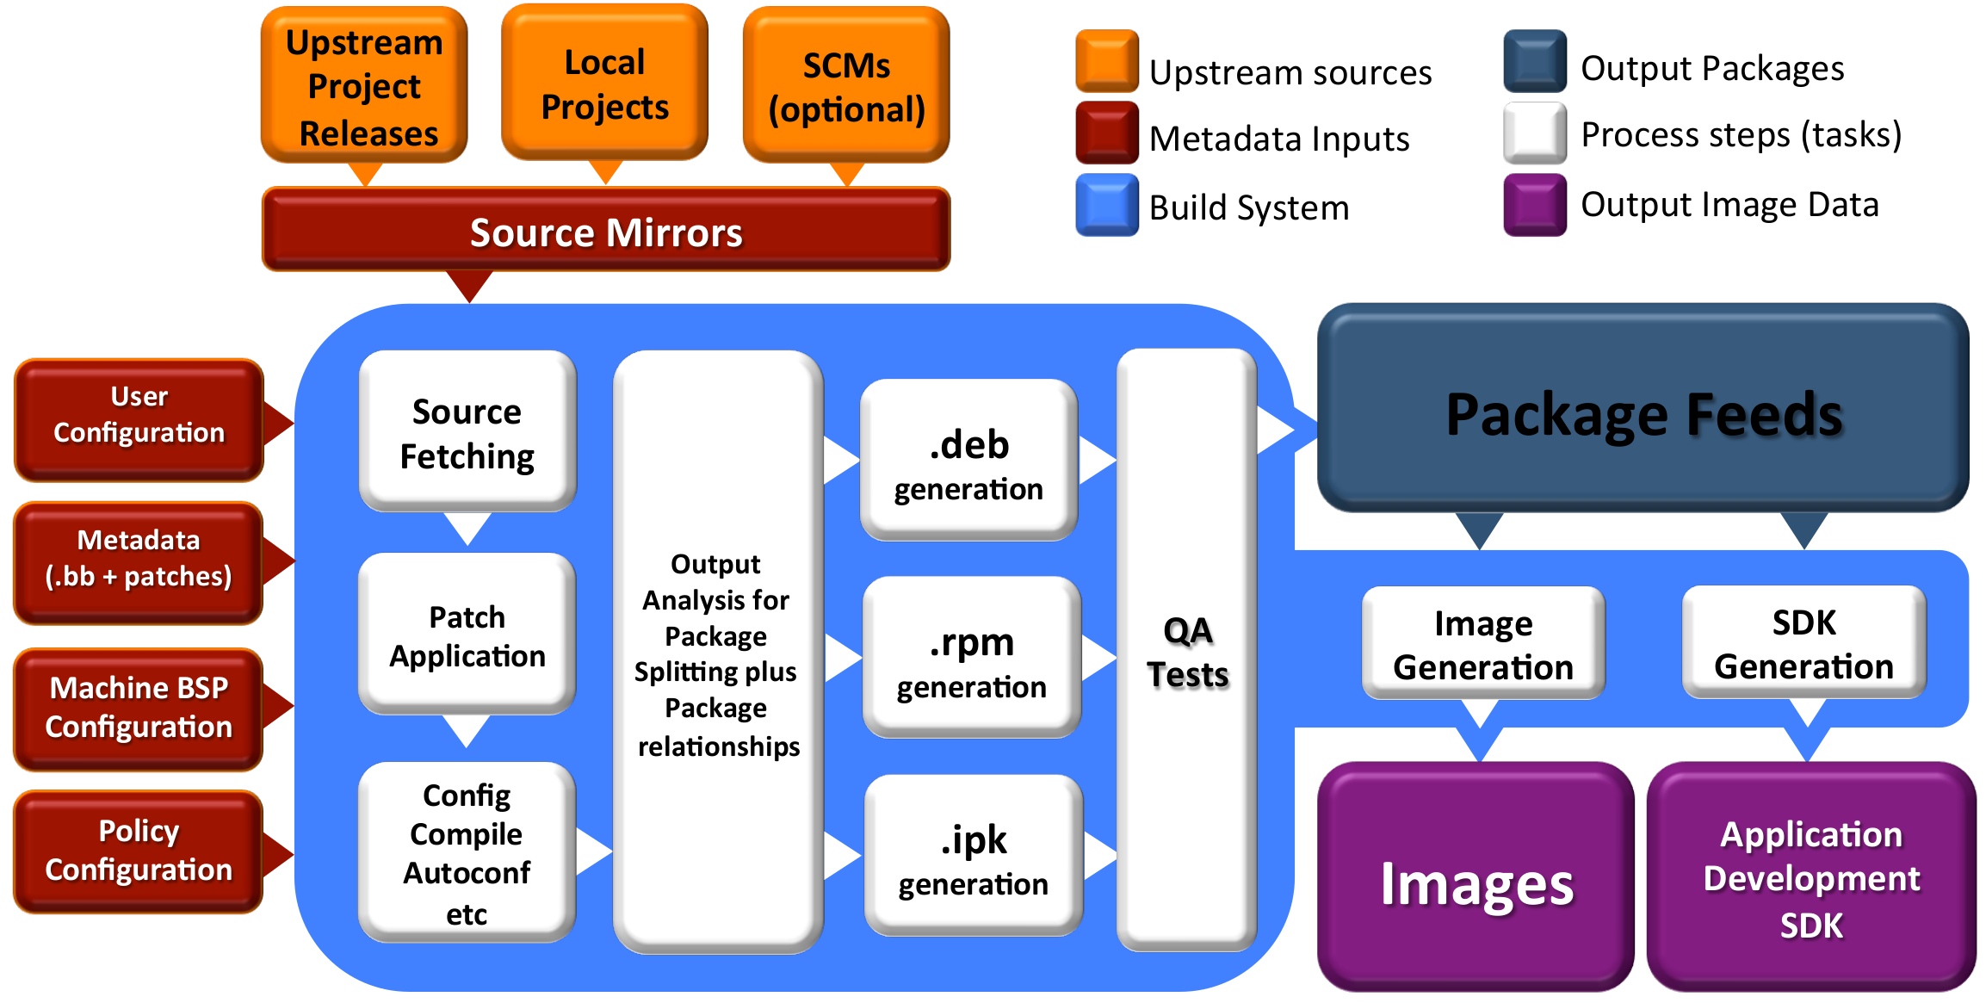
Build System Workflow
‹#›

Slide 17
BITBAKE
This section will introduce the concept of the bitbake build tool and how it can be used to build recipes
‹#›

Slide 18
Metadata and bitbake
Most common form of metadata: The Recipe
A Recipe provides a “list of ingredients” and “cooking instructions”
Defines settings and a set of tasks used by bitbake to build binary packages
busybox
Metadata
glibc
BitBake
sysvinit
coreutils
libgtk
Notes:
Concepts
© 2014 Mentor Graphics Corporation
Mentor Embedded Linux Training
‹#›

Slide 19
What is Metadata?
Metadata exists in four general categories:
Recipes (*.bb)
Usually describe build instructions for a single package
PackageGroups (special *.bb)
Often used to group packages together for a FS image
Classes (*.bbclass)
Inheritance mechanism for common functionality
Configuration (*.conf)
Drives the overall behavior of the build process
Notes:
Concepts
© 2014 Mentor Graphics Corporation
Mentor Embedded Linux Training
‹#›

Slide 20
Other Metadata
Append files (*.bbappend)
Define additional metadata for a similarly named .bb file
Can add or override previously set values
Include files (*.inc)
Files which are used with the include directive
Include files are typical found via the BBPATH variable
Notes:
Concepts
© 2014 Mentor Graphics Corporation
Mentor Embedded Linux Training
‹#›

Slide 21
OE-CORE Breakdown
*.bb: 1562
Packagegroup*: 34
*.bbclass: 193
*.conf: 108
*.inc: 386
‹#›

Slide 22
Introduction to Bitbake
Bitbake is a task executor and scheduler
By default the build task for the specified recipe is executed
$ bitbake myrecipe
You can indicate which task you want run
$ bitbake -c clean myrecipe
You can get a list of tasks with
$ bitbake -c listtasks myrecipe
Notes:
Concepts
© 2014 Mentor Graphics Corporation
Mentor Embedded Linux Training
‹#›

Slide 23
Building Recipes
By default the highest version of a recipe is built (can be overridden with DEFAULT_PREFERENCE or PREFERRED_VERSION metadata)
$ bitbake myrecipe
You can specify the version of the package you want built (version of upstream source)
$ bitbake myrecipe-1.0
You can also build a particular revision of the package metadata
$ bitbake myrecipe-1.0-r0
Or you can provide a recipe file to build
$ bitbake -b mydir/myrecip.bb
Notes:
Concepts
© 2014 Mentor Graphics Corporation
Mentor Embedded Linux Training
‹#›

Slide 24
Running bitbake for the First Time
When you do a really big build, running with --continue (-k) means bitbake will proceed as far as possible after finding an error
$ bitbake -k core-image-minimal
When running a long build (e.g. overnight) you want as much of the build done as possible before debugging issues
Running bitbake normally will stop on the first error found
$ bitbake core-image-minimal
We'll look at debugging recipe issue later...
Notes:
Concepts
© 2014 Mentor Graphics Corporation
Mentor Embedded Linux Training
‹#›

Slide 25
Bitbake is a Task Scheduler
Bitbake builds recipes by scheduling build tasks in parallel
$ bitbake recipe
This looks for recipe.bb in BBFILES
Each recipe defines build tasks, each which can depend on other tasks
Recipes can also depend on other recipes, meaning more than one recipe may be built
Tasks from more than one recipe are often executed in parallel at once on multi-cpu build machines
‹#›

Slide 26
Recipe Basics – Default Tasks*
do_fetch
Locate and download source code
do_unpack
Unpack source into working directory
do_patch
Apply any patches
do_configure
Perform any necessary pre-build configuration
do_compile
Compile the source code
Installation of resulting build artifacts in WORKDIR
do_install
do_populate_sysroot
Copy artifacts to sysroot
do_package_*
Create binary package(s)
Note: to see the list of all possible tasks for a recipe, do this:
$ bitbake -c listtasks <recipe_name>
*Simplified for illustration
Notes:
Fetch: where and how to download source code
Packages: each recipe by default produce 4 packages: binary package, doc package, dev package (.h, .so, .a), debug package (binary contain symbolic for debugging)
Setscene:
Concepts
© 2014 Mentor Graphics Corporation
Mentor Embedded Linux Training
‹#›

Slide 27
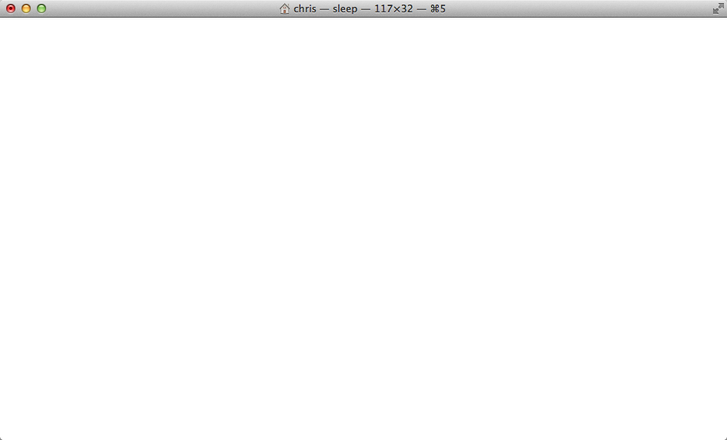
Simple recipe task list*
$ bitbake hello
NOTE: Running task 337 of 379 (ID: 4, hello_1.0.0.bb, do_fetch)
NOTE: Running task 368 of 379 (ID: 0, hello_1.0.0.bb, do_unpack)
NOTE: Running task 369 of 379 (ID: 1, hello_1.0.0.bb, do_patch)
NOTE: Running task 370 of 379 (ID: 5, hello_1.0.0.bb, do_configure)
NOTE: Running task 371 of 379 (ID: 7, hello_1.0.0.bb, do_populate_lic)
NOTE: Running task 372 of 379 (ID: 6, hello_1.0.0.bb, do_compile)
NOTE: Running task 373 of 379 (ID: 2, hello_1.0.0.bb, do_install)
NOTE: Running task 374 of 379 (ID: 11, hello_1.0.0.bb, do_package)
NOTE: Running task 375 of 379 (ID: 3, hello_1.0.0.bb, do_populate_sysroot)
NOTE: Running task 376 of 379 (ID: 8, hello_1.0.0.bb, do_packagedata)
NOTE: Running task 377 of 379 (ID: 12, hello_1.0.0.bb, do_package_write_ipk)
NOTE: Running task 378 of 379 (ID: 9, hello_1.0.0.bb, do_package_qa)
*Output has been formatted to fit this slide.
*Simplified for illustration
‹#›
Notes:
Fetch: where and how to download source code
Packages: each recipe by default produce 4 packages: binary package, doc package, dev package (.h, .so, .a), debug package (binary contain symbolic for debugging)
package_qa: collections of "sanity" checks including cross-compile badness such as cross-binaries linked to host libs, valid paths in .pc/.la files, other common errors, etc. See insane.bbclass
Concepts
© 2014 Mentor Graphics Corporation
Mentor Embedded Linux Training
‹#›

Slide 28
SSTATE CACHE
Several bitbake tasks can use past versions of build artefacts if there have been no changes since the last time you built them
do_packagedata | Creates package metadata used by the build system to generate the final packages
do_package | Analyzes the content of the holding area and splits it into subsets based on available packages and files
do_package_write_rpm | Creates the actual RPM packages and places them in the Package Feed area
do_populate_lic | Writes license information for the recipe that is collected later when the image is constructed
do_populate_sysroot | Copies a subset of files installed by do_install into the sysroot in order to make them available to other recipes
‹#›

Slide 29
Simple recipe build from sstate cache*
$ bitbake -c clean hello
$ bitbake hello
NOTE: Running setscene task 69 of 74 (hello_1.0.0.bb, do_populate_sysroot_setscene)
NOTE: Running setscene task 70 of 74 (hello_1.0.0.bb, do_populate_lic_setscene)
NOTE: Running setscene task 71 of 74 (hello_1.0.0.bb, do_package_qa_setscene)
NOTE: Running setscene task 72 of 74 (hello_1.0.0.bb, do_package_write_ipk_setscene)
NOTE: Running setscene task 73 of 74 (hello_1.0.0.bb, do_packagedata_setscene)
*Output has been formatted to fit this slide.
*Simplified for illustration
‹#›
Notes:
Fetch: where and how to download source code
Packages: each recipe by default produce 4 packages: binary package, doc package, dev package (.h, .so, .a), debug package (binary contain symbolic for debugging)
Setscene:
Concepts
© 2014 Mentor Graphics Corporation
Mentor Embedded Linux Training
‹#›

Slide 30
RECIPES
This section will introduce the concept of metadata and recipes and how they can be used to automate the building of packages
‹#›

Slide 31
What is a Recipe?
A recipe is a set of instructions for building packages, including:
Where to obtain the upstream sources and which patches to apply (this is called “fetching”)
SRC_URI
Dependencies (on libraries or other recipes)
DEPENDS, RDEPENDS
Configuration/compilation options
EXTRA_OECONF, EXTRA_OEMAKE
Define which files go into what output packages
FILES_*
‹#›

Slide 32
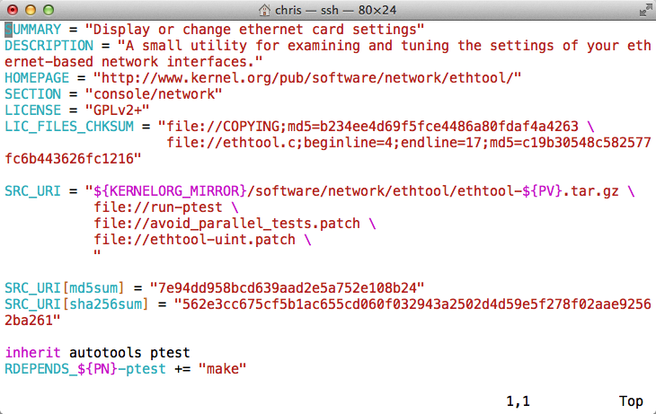
Example Recipe – ethtool_3.15.bb
‹#›

Slide 33
What can a Recipe Do?
Build one or more packages from source code
Host tools, compiler, utilities
Bootloader, Kernel, etc
Libraries, interpretors, etc
Userspace applications
Package Groups
Full System Images
‹#›

Slide 34
Recipe Operators
A = “foo” (late assignment)
B ?= “0t” (default value)
C ??= “abc” (late default)
D := “xyz” (Immediate assignment)
A .= “bar” “foobar” (append)
B =. “WO” “W00t” (prepend)
C += “def” “abc def” (append)
D =+ “uvw” “uvw xyz” (prepend)
‹#›

Slide 35
More Recipe Operators
A = “foo”
A_append = “bar” “foobar”
B = “0t”
B_prepend = “WO” “W00t”
OVERRIDES = “os:arch:machine”
A = “abc”
A_os = “ABC” (Override)
A_append_arch = “def” (Conditional append)
A_prepend_os = “XYZ” (Conditional prepend)
‹#›

Slide 36
Bitbake Variables/Metadata
These are set automatically by bitbake
TOPDIR – The build directory
LAYERDIR – Current layer directory
FILE – Path and filename of file being processed
Policy variables control the build
BUILD_ARCH – Host machine architecture
TARGET_ARCH – Target architecture
And many others...
‹#›

Slide 37
Build Time Metadata
PN – Pakage name (“myrecipe”)
PV – Package version (1.0)
PR – Package Release (r0)
P = “${PN}-${PV}”
PF = “${PN}-${PV}-${PR}”
FILE_DIRNAME – Directory for FILE
FILESPATH = "${FILE_DIRNAME}/${PF}:\
${FILE_DIRNAME}/${P}:\
${FILE_DIRNAME}/${PN}:\
${FILE_DIRNAME}/files:${FILE_DIRNAME}
‹#›

Slide 38
Build Time Metadata
TOPDIR – The build directory
TMPDIR = “${TOPDIR}/tmp”
WORKDIR = ${TMPDIR}/work/${PF}”
S = “${WORKDIR}/${P}” (Source dir)
B = “${S}” (Build dir)
D = “${WORKDIR}/${image}” (Destination dir)
DEPLOY_DIR = “${TMPDIR}/deploy”
DEPLOY_DIR_IMAGE = “${DEPLOY_DIR}/images”
‹#›

Slide 39
Dependency Metadata
Build time package variables
DEPENDS – Build time package dependencies
PROVIDES = “${P} ${PF} ${PN}”
Runtime package variables
RDEPENDS – Runtime package dependencies
RRECOMMENDS – Runtime recommended packages
RSUGGESTS – Runtime suggested packages
RPROVIDES – Runtime provides
RCONFLICTS – Runtime package conflicts
RREPLACES – Runtime package replaces
‹#›

Slide 40
Common Metadata
Variables you commonly set
SUMMARY – Short description of package/recipe
HOMEPAGE – Upstream web page
LICENSE – Licenses of included source code
LIC_FILES_CHKSUM – Checksums of license files at time of packaging (checked for change by build)
SRC_URI – URI of source code, patches and extra files to be used to build packages. Uses different fetchers based on the URI.
FILES – Files to be included in binary packages
‹#›

Slide 41
Examining Recipes: bc
Look at 'bc' recipe:
Found in
poky/meta/recipes-extended/bc/bc_1.06.bb
Uses LIC_FILES_CHKSUM and SRC_URI checksums
Note the DEPENDS build dependency declaration indicating that this package depends on flex to build
‹#›

Slide 42
Examining Recipes: bc.bb
SUMMARY = "Arbitrary precision calculator language"
HOMEPAGE = "http://www.gnu.org/software/bc/bc.html"
LICENSE = "GPLv2+ & LGPLv2.1"
LIC_FILES_CHKSUM = "file://COPYING;md5=94d55d512a9ba36caa9b7df079bae19f \
file://COPYING.LIB;md5=d8045f3b8f929c1cb29a1e3fd737b499 \
file://bc/bcdefs.h;endline=31;md5=46dffdaf10a99728dd8ce358e45d46d8 \
file://dc/dc.h;endline=25;md5=2f9c558cdd80e31b4d904e48c2374328 \
file://lib/number.c;endline=31;md5=99434a0898abca7784acfd36b8191199"
SECTION = "base"
DEPENDS = "flex"
PR = "r3"
SRC_URI = "${GNU_MIRROR}/bc/bc-${PV}.tar.gz \
file://fix-segment-fault.patch "
SRC_URI[md5sum] = "d44b5dddebd8a7a7309aea6c36fda117"
SRC_URI[sha256sum] = "4ef6d9f17c3c0d92d8798e35666175ecd3d8efac4009d6457b5c99cea72c0e33"
inherit autotools texinfo update-alternatives
ALTERNATIVE_${PN} = "dc"
ALTERNATIVE_PRIORITY = "100"
BBCLASSEXTEND = "native"
‹#›

Slide 43
Building upon bbclass
Use inheritance for common design patterns
Provide a class file (.bbclass) which is then inherited by other recipes (.bb files)
inherit autotools
Bitbake will include the autotools.bbclass file
Found in a classes directory via the BBPATH
‹#›

Slide 44
Examining Recipes: flac
Look at 'flac' recipe
Found in
poky/meta/recipes-multimedia/flac/flac_1.3.1.bb
Inherits from both autotools and gettext
Customizes autoconf configure options (EXTRA_OECONF) based on "TUNE" features
Breaks up output into multiple binary packages
See PACKAGES var. This recipe produces additional packages with those names, while the FILES_* vars specify which files go into these additional packages
‹#›

Slide 45
Examining Recipes: flac.bb
SUMMARY = "Free Lossless Audio Codec"
DESCRIPTION = "FLAC stands for Free Lossless Audio Codec, a lossless audio compression format."
HOMEPAGE = "https://xiph.org/flac/"
BUGTRACKER = "http://sourceforge.net/p/flac/bugs/"
SECTION = "libs"
LICENSE = "GFDL-1.2 & GPLv2+ & LGPLv2.1+ & BSD"
LIC_FILES_CHKSUM = "file://COPYING.FDL;md5=ad1419ecc56e060eccf8184a87c4285f \
file://src/Makefile.am;beginline=1;endline=17;md5=0a853b81d9d43d8aad3b53b05cfcc37e \
file://COPYING.GPL;md5=b234ee4d69f5fce4486a80fdaf4a4263 \
file://src/flac/main.c;beginline=1;endline=18;md5=d03a766558d233f9cc3ac5dfafd49deb \
file://COPYING.LGPL;md5=fbc093901857fcd118f065f900982c24 \
file://src/plugin_common/all.h;beginline=1;endline=18;md5=7c8a3b9e1e66ed0aba765bc6f35da85d \
file://COPYING.Xiph;md5=a2c4b71c0198682376d483eb5bcc9197 \
file://include/FLAC/all.h;beginline=65;endline=70;md5=64474f2b22e9e77b28d8b8b25c983a48"
DEPENDS = "libogg"
SRC_URI = "http://downloads.xiph.org/releases/flac/${BP}.tar.xz"
SRC_URI[md5sum] = "b9922c9a0378c88d3e901b234f852698"
SRC_URI[sha256sum] = "4773c0099dba767d963fd92143263be338c48702172e8754b9bc5103efe1c56c"
(con't next page)
‹#›

Slide 46
Examining Recipes: flac.bb (con't)
(con't from previous page)
inherit autotools gettext
EXTRA_OECONF = "--disable-oggtest \
--with-ogg-libraries=${STAGING_LIBDIR} \
--with-ogg-includes=${STAGING_INCDIR} \
--disable-xmms-plugin \
--without-libiconv-prefix \
ac_cv_prog_NASM="" \
"
EXTRA_OECONF += "${@bb.utils.contains("TUNE_FEATURES", "altivec", " --enable-altivec", \
" --disable-altivec", d)}"
EXTRA_OECONF += "${@bb.utils.contains("TUNE_FEATURES", "core2", " --enable-sse", "", d)}"
EXTRA_OECONF += "${@bb.utils.contains("TUNE_FEATURES", "corei7", " --enable-sse", "", d)}"
PACKAGES += "libflac libflac++ liboggflac liboggflac++"
FILES_${PN} = "${bindir}/*"
FILES_libflac = "${libdir}/libFLAC.so.*"
FILES_libflac++ = "${libdir}/libFLAC++.so.*"
FILES_liboggflac = "${libdir}/libOggFLAC.so.*"
FILES_liboggflac++ = "${libdir}/libOggFLAC++.so.*"
‹#›

Slide 47
Grouping Local Metadata
Sometimes sharing metadata between recipes is easier via an include file
include file.inc
Will include .inc file if found via BBPATH
Can also specify an absolute path
If not found, will continue without an error
require file.inc
Same as an include
Fails with an error if not found
‹#›

Slide 48
Examining Recipes: ofono
Look at 'ofono' recipe(s):
Found in
poky/meta/recipes-connectivity/ofono/ofono_1.16.bb
Splits recipe into common .inc file to share common metadata between multiple recipes
Sets a conditional build configuration options through the PACKAGECONFIG var based on a DISTRO_FEATURE (in the .inc file)
Sets up an init service via do_install_append()
Has a _git version of the recipe (not shown)
‹#›

Slide 49
Examining Recipes: ofono.bb
require ofono.inc
SRC_URI = "\
${KERNELORG_MIRROR}/linux/network/${BPN}/${BP}.tar.xz \
file://ofono \
file://Revert-test-Convert-to-Python-3.patch \
file://0001-backtrace-Disable-for-non-glibc-C-libraries.patch \
"
SRC_URI[md5sum] = "c31b5b55a1d68354bff771d3edf02829"
SRC_URI[sha256sum] = \
"403b98dadece8bc804c0bd16b96d3db5a3bb0f84af64b3d67924da2d1a754b07"
CFLAGS_append_libc-uclibc = " -D_GNU_SOURCE"
‹#›

Slide 50
Examining Recipes: ofono.inc
HOMEPAGE = "http://www.ofono.org"
SUMMARY = "open source telephony"
DESCRIPTION = "oFono is a stack for mobile telephony devices on Linux. oFono supports speaking to telephony devices through specific drivers, or with generic AT commands."
LICENSE = "GPLv2"
LIC_FILES_CHKSUM = "file://COPYING;md5=eb723b61539feef013de476e68b5c50a \
file://src/ofono.h;beginline=1;endline=20;md5=3ce17d5978ef3445def265b98899c2ee"
inherit autotools pkgconfig update-rc.d systemd bluetooth
DEPENDS = "dbus glib-2.0 udev mobile-broadband-provider-info"
INITSCRIPT_NAME = "ofono"
INITSCRIPT_PARAMS = "defaults 22"
PACKAGECONFIG ??= "\
${@bb.utils.contains('DISTRO_FEATURES', 'systemd', 'systemd', '', d)} \
${@bb.utils.contains('DISTRO_FEATURES', 'bluetooth', 'bluez', '', d)} \
"
PACKAGECONFIG[systemd] = "--with-systemdunitdir=${systemd_unitdir}/system/, \
--with-systemdunitdir="
PACKAGECONFIG[bluez] = "--enable-bluetooth, --disable-bluetooth, ${BLUEZ}"
(con't next page)
‹#›

Slide 51
Examining Recipes: ofono.inc
(con't from previous page)
EXTRA_OECONF += "--enable-test"
SYSTEMD_SERVICE_${PN} = "ofono.service"
do_install_append() {
install -d ${D}${sysconfdir}/init.d/
install -m 0755 ${WORKDIR}/ofono ${D}${sysconfdir}/init.d/ofono
}
PACKAGES =+ "${PN}-tests"
RDEPENDS_${PN} += "dbus"
FILES_${PN} += "${base_libdir}/udev ${systemd_unitdir}"
FILES_${PN}-tests = "${libdir}/${BPN}/test"
RDEPENDS_${PN}-tests = "python python-pygobject python-dbus"
‹#›

Slide 52
WHEN THINGS GO WRONG
Some useful tools to help guide you when something goes wrong
‹#›

Slide 53
Bitbake Environment
Each recipe has its own environment which contains all the variables and methods required to build that recipe
You've seen some of the variables already
DESCRIPTION, SRC_URI, LICENSE, S, LIC_FILES_CHKSUM, do_compile(), do_install()
Example
S = "${WORKDIR}"
What does this mean?

Slide 54
Examine a Recipe's Environment
To view a recipe's envrionment
$ bitbake -e myrecipe
Where is the source code for this recipe"
$ bitbake -e virtual/kernel | grep “^S=”
S="${HOME}/yocto/build/tmp/work-shared/qemuarm/kernel-source"
What file was used in building this recipe?
$ bitbake -e netbase | grep “^FILE=”
FILE="${HOME}/yocto/poky/meta/recipes-core/netbase/netbase_5.3.bb"
‹#›

Slide 55
Examine a Recipe's Environment (cont'd)
What is this recipe's full version string?
$ bitbake -e netbase | grep “^PF=”
PF="netbase-1_5.3-r0"
Where is this recipe's BUILD directory?
$ bitbake -e virtual/kernel | grep “^B=”
B="${HOME}/yocto/build/tmp/work/qemuarm-poky-linux-\
gnueabi/linux-yocto/3.19.2+gitAUTOINC+9e70b482d3\
_473e2f3788-r0/linux-qemuarm-standard-build"
What packages were produced by this recipe?
$ bitbake -e virtual/kernel | grep “^PACKAGES=”
PACKAGES="kernel kernel-base kernel-vmlinux kernel-image \ kernel-dev kernel-modules kernel-devicetree"
‹#›

Slide 56
BitBake Log Files
Every build produces lots of log output for diagnostics and error chasing
Verbose log of bitbake console output:
Look in …/tmp/log/cooker/<machine>
$ cat tmp/log/cooker/qemuarm/20160119073325.log | grep 'NOTE:.*task.*Started'
NOTE: recipe hello-1.0.0-r0: task do_fetch: Started
NOTE: recipe hello-1.0.0-r0: task do_unpack: Started
NOTE: recipe hello-1.0.0-r0: task do_patch: Started
NOTE: recipe hello-1.0.0-r0: task do_configure: Started
NOTE: recipe hello-1.0.0-r0: task do_populate_lic: Started
NOTE: recipe hello-1.0.0-r0: task do_compile: Started
NOTE: recipe hello-1.0.0-r0: task do_install: Started
NOTE: recipe hello-1.0.0-r0: task do_populate_sysroot: Started
NOTE: recipe hello-1.0.0-r0: task do_package: Started
NOTE: recipe hello-1.0.0-r0: task do_packagedata: Started
NOTE: recipe hello-1.0.0-r0: task do_package_write_rpm: Started
NOTE: recipe hello-1.0.0-r0: task do_package_qa: Started
NOTE: recipe ypdd-image-1.0-r0: task do_rootfs: Started
‹#›

Slide 57
BitBake Per-Recipe Log Files
Every recipe produces lots of log output for diagnostics and debugging
Use the Environment to find the log files for a given recipe:
$ bitbake -e hello | grep “^T=”
T="${HOME}yocto/build/tmp/work/armv5e-poky-linux-gnueabi/hello/1.0.0-r0/temp"
Each task that runs for a recipe produces "log" and "run" files in
${WORKDIR}/temp
‹#›

Slide 58
BitBake Per-Recipe Log Files
$ cd ${T} (See definition of T in previous slide)
$ find . -type l -name 'log.*'
./log.do_package_qa
./log.do_package_write_rpm
./log.do_package
./log.do_fetch
./log.do_populate_lic
./log.do_install
./log.do_configure
./log.do_unpack
./log.do_populate_sysroot
./log.do_compile
./log.do_packagedata
./log.do_patch
These files contain the output of the respective tasks for each recipe
‹#›

Slide 59
BitBake Per-Recipe Log Files
$ cd ${T} (See definition of T in previous slide)
$ find . -type l -name 'run.*'
./run.do_fetch
./run.do_patch
./run.do_configure
./run.do_populate_sysroot
./run.do_package_qa
./run.do_unpack
./run.do_compile
./run.do_install
./run.do_packagedata
./run.do_populate_lic
./run.do_package
./run.do_package_write_rpm
These files contain the commands executed which produce the build results
‹#›

Slide 60
BUILDING A FULL EMBEDDED IMAGE WITH YOCTO
This section will introduce the concept of building an initial system image
‹#›

Slide 61
Quick Start Guide in one Slide
Download Yocto Project sources:
$ wget http://downloads.yoctoproject.org/releases/yocto/yocto-2.1.1/poky-krogoth-15.0.1.tar.bz2
$ tar xf poky-krogoth-15.0.1.tar.bz2
Can also use git and checkout a known branch e.g. krogoth
$ git clone -b krogoth git://git.yoctoproject.org/poky.git
Build one of the reference Linux distributions:
$ source poky-krogoth-15.0.1/oe-init-build-env
Check/Edit local.conf for sanity (e.g. modify MACHINE = “qemux86” or MACHINE = “qemuarm”)
build$ bitbake -k core-image-minimal
Run the image under emulation:
$ runqemu qemux86
Profit!!! (well… actually there is more work to do...)
‹#›

Slide 62
Host System Layout
$HOME/yocto/
|---build (or whatever name you choose)
Project build directory
|---downloads (DL_DIR)
Downloaded source cache
|---poky (Do Not Modify anything in here*)
Poky, bitbake, scripts, oe-core, metadata
|---sstate-cache (SSTATE_DIR)
Binary build cache
* We will cover how to use layers to make changes later
‹#›

Slide 63
Poky Layout
$HOME/yocto/poky/
|---LICENSE
|---README
|---README.hardware
|---bitbake/ (The build tool)
|---documentation/
|---meta/ (oe-core)
|---meta-poky/ (Yocto distro metadata)
|---meta-yocto-bsp/ (Yocto Reference BSPs)
|---oe-init-build-env (Project setup script)
|---scripts/ (Scripts and utilities)
meta-yocto-bsp
meta-poky
oe-core (meta)
Note: A few files have been items omitted to facility the presentation on this slide
‹#›

Slide 64
Setting up a Build Directory
Start by setting up a build directory
Local configuration
Temporary build artifacts
$ cd $HOME/yocto/
$ source ./poky/oe-init-build-env [prjdir]
Replace build with whatever directory name you want to use for your project
You need to re-run this script in any new terminal you start (and don’t forget the project directory)
‹#›

Slide 65
Build directory Layout
$HOME/yocto/build/
|---bitbake.lock
|---cache/ (bitbake cache files)
|---conf/
| |--bblayers.conf (bitbake layers)
| |--local.conf (local configuration)
| `--site.conf (optional site conf)
`---tmp/ (Build artifacts)
Note: A few files have been items omitted to facility the presentation on this slide
‹#›

Slide 66
Building a Linux Image
General Procedure:
Create a project directory using
source oe-init-build-env [prj-dir]
Configure build by editing local.conf
$HOME/yocto/build/conf/local.conf
Select appropriate MACHINE type
Set shared downloads directory (DL_DIR)
Set shared state directory (SSTATE_DIR)
Build your selected Image
$ bitbake -k core-image-minimal
(Detailed steps follow…)
‹#›

Slide 67
Update Build Configuration
Configure build by editing local.conf
$HOME/yocto/build/conf/local.conf
Set appropriate MACHINE, DL_DIR and SSTATE_DIR
Add the following to the bottom of local.conf
MACHINE = "qemuarm"
DL_DIR = "${TOPDIR}/../downloads"
SSTATE_DIR = "${TOPDIR}/../sstate-cache/${MACHINE}"
Notice how you can use variables in setting these values
‹#›

Slide 68
Building an Embedded Image
This builds an entire embedded Linux distribution
Choose from one of the available Images
The following builds a minimal embedded target
$ bitbake -k core-image-minimal
On a fast computer the first build may take the better part of an hour on a slow machine multiple ...
The next time you build it (with no changes) it may take as little as 5 mins (due to the shared state cache)
‹#›

Slide 69
Booting Your Image with QEMU
The runqemu script is used to boot the image with QEMU
It auto-detects settings as much as possible, enabling the following command to boot our reference images:
$ runqemu qemuarm [nographic]
Use nographic if using a non-graphical session (ssh), do not type the square brackets
Replace qemuarm with your value of MACHINE
Your QEMU instance should boot
Quit by closing the qemu window
If using “nographic”, kill it from another terminal:
$ killall qemu-system-arm
‹#›

Slide 70
LAYERS
This section will introduce the concept of layers and how important they are in the overall build architecture
‹#›

Slide 71
Layers
Metadata is provided in a series of layers which allow you to override any value without editing the originally provided files
A layer is a logical collection of metadata in the form of recipes
A layer is used to represent oe-core, a Board Support Package (BSP), an application stack, and your new code
All layers have a priority and can override policy, metadata and config settings of layers with a lesser priority
‹#›

Slide 72
Layer Hierarchy
Developer layer(s)
Commercial layers (OSV or middleware)
UI/GUI layer
BSP layer
meta-poky
meta (oe-core)
‹#›

Slide 73
Using Layers
Layers are added to your build by inserting them into the BBLAYERS variable within your bblayers file
$HOME/yocto/build/conf/bblayers.conf
BBLAYERS ?= " \
${HOME}/yocto/poky/meta \
${HOME}/yocto/poky/meta-poky \
${HOME}/yocto/poky/meta-yocto-bsp \
"
‹#›

Slide 74
Board Support Packages
BSPs are layers to enable support for specific hardware platforms
Defines machine configuration variables for the board (MACHINE)
Adds machine-specific recipes and customizations
Boot loader
Kernel config
Graphics drivers (e.g, Xorg)
Additional recipes to support hardware features
‹#›

Slide 75
Notes on using Layers
When doing development with Yocto, do not edit files within the Poky source tree
Use a new custom layer for modularity and maintainability
Layers also allow you to easily port from one version of Yocto/Poky to the next version
‹#›

Slide 76
Creating a Custom Layer
Layers can be created manually
They all start with “meta-” by convention
However using the yocto-layer tool is easier
$ yocto-layer create ypdd
This will create meta-ypdd in the current dir
For Board Support Package Layers there is the yocto-bsp tool
$ yocto-bsp create mybsp arm
This will create meta-mybsp in the current dir
‹#›

Slide 77
Create a Custom Layer
$ cd yocto
yocto$ source poky/oe-init-build-env build
yocto/build$ yocto-layer create ypdd
Please enter the layer priority you'd like to use for the layer: [default: 6] 6
Would you like to have an example recipe created? (y/n) [default: n] y
Please enter the name you'd like to use for your example recipe: [default: example] example
Would you like to have an example bbappend file created? (y/n) [default: n] n
New layer created in meta-ypdd.
Don't forget to add it to your BBLAYERS (for details see meta-ypdd\README).
yocto/build$
‹#›

Slide 78
The new Custom Layer
yocto/build$ tree meta-ypdd
meta-ypdd/
|--COPYING.MIT (The license file)
|--README (Starting point for README)
|--conf
| `--layer.conf (Layer configuration file)
`--recipes-example (A grouping of recipies)
`--example (The example package)
|--example-0.1 (files for v0.1 of example)
| |--example.patch
| `--helloworld.c
`--example_0.1.bb (The example recipe)
‹#›

Slide 79
Layer.conf
# We have a conf and classes directory, add to BBPATH
BBPATH .= ":${LAYERDIR}"
# We have recipes-* directories, add to BBFILES
BBFILES += "${LAYERDIR}/recipes-*/*/*.bb \
${LAYERDIR}/recipes-*/*/*.bbappend"
BBFILE_COLLECTIONS += "ypdd"
BBFILE_PATTERN_ypdd = "^${LAYERDIR}/"
BBFILE_PRIORITY_ypdd = "6"
‹#›

Slide 80
Adding Layers to Your Build
Add your layer to bblayers.conf
$HOME/yocto/build/conf/bblayers.conf
BBLAYERS ?= " \
${HOME}/yocto/poky/meta \
${HOME}/yocto/poky/meta-poky \
${HOME}/yocto/poky/meta-yocto-bsp \
${HOME}/yocto/build/meta-ypdd \
“
‹#›

Slide 81
Build Your New Recipe
You can now build the new recipe
$ bitbake example
This will now build the example_0.1.bb recipe which is found in
meta-ypdd/recipes-example/example/example_0.1.bb
Note: Build fails w/o ${CFLAGS} and ${LDFLAGS} meanwhile (QA-error) in the recipe.
‹#›

Slide 82
IMAGES
This section will introduce the concept of images; recipes which build embedded system images
‹#›

Slide 83
What is an Image?
Building an image creates an entire Linux distribution from source
Compiler, tools, libraries
BSP: Bootloader, Kernel
Root filesystem:
Base OS
services
Applications
etc
‹#›

Slide 84
Extending an Image
You often need to create your own Image recipe in order to add new packages or functionality
With Yocto/OpenEmbedded it is always preferable to extend an existing recipe or inherit a class
The simplest way is to inherit the core-image bbclass
You add packages to the image by adding them to IMAGE_INSTALL
‹#›

Slide 85
A Simple Image Recipe
Create an images directory
$ mkdir -p ${HOME}/yocto/build/meta-ypdd/recipes-core/images
Create the image recipe
$ vi ${HOME}/yocto/build/meta-ypdd/recipes-core/images/ypdd-image.bb
DESCRIPTION = "A core image for YPDD"
LICENSE = "MIT"
# Core files for basic console boot
IMAGE_INSTALL = "packagegroup-core-boot"
# Add our desired packages
IMAGE_INSTALL += "psplash dropbear"
inherit core-image
IMAGE_ROOTFS_SIZE ?= "8192"
‹#›

Slide 86
Build and Boot Your Custom Image
Enable the meta-ypdd layer in your build
Edit conf/bblayers.conf and add the path to meta-ypdd to the BBLAYERS variable declaration
(example in the next slide)
‹#›

Slide 87
Add Your Layer
Make sure your layer is added to BBLAYERS in bblayers.conf
$HOME/yocto/build/conf/bblayers.conf
BBLAYERS ?= " \
${HOME}/yocto/poky/meta \
${HOME}/yocto/poky/meta-poky \
${HOME}/yocto/poky/meta-yocto-bsp \
${HOME}/yocto/build/meta-ypdd \
"
(We already did this step in a previous section)
‹#›

Slide 88
Build and Boot Your Custom Image
Build your custom image:
$ bitbake ypdd-image
(If your SSTATE_DIR is configured correctly from a previous build this should take less than 5 minutes)
Boot the image with QEMU:
$ runqemu qemuarm \
tmp/deploy/images/qemuarm/ypdd-image-qemuarm.ext4 \
[nographic]
Use nographic if using ssh environment
‹#›

Slide 89
Build and Boot Your Custom Image
Verify that dropbear ssh server is present
$ which dropbear
If you used the graphical invocation of QEMU using VNC viewer, you will see the splash screen on boot.
‹#›

Slide 90
Toaster
The following section introduces toaster
‹#›

Slide 91
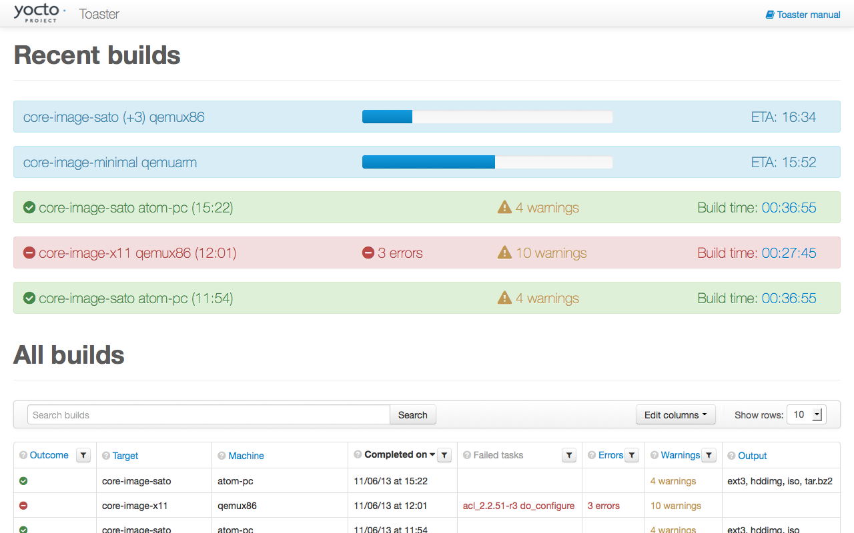

Slide 92
About Toaster
Toaster is a web interface to OpenEmbedded and BitBake, the Yocto Project build system.
Toaster allows you configure and run your builds, and provides information and statistics about the build process.
‹#›

Slide 93
toaster in one slide
Download clone poky git repo:
$ mkdir -p ${HOME}/toaster ; cd ${HOME}/toaster $ git clone -b krogoth git://git.yoctoproject.org/poky
# Note: git checkout is required by toaster - do not use the release tarball
Download/install dependencies:
$ sudo apt-get install python-virtualenv $ virtualenv venv $ source venv/bin/activate # you’ll have to activate it every time to enter the environment (venv)$ pip install -r poky/bitbake/toaster-requirements.txt
Start toaster:
(venv)$ source poky/oe-init-build-env toasterprjdir
(venv)$ . ../poky/bitbake/bin/toaster start # wait 2 minutes …
Profit!!! (well… actually there is more work to do...)
$ firefox http://localhost:8000
‹#›

Slide 94
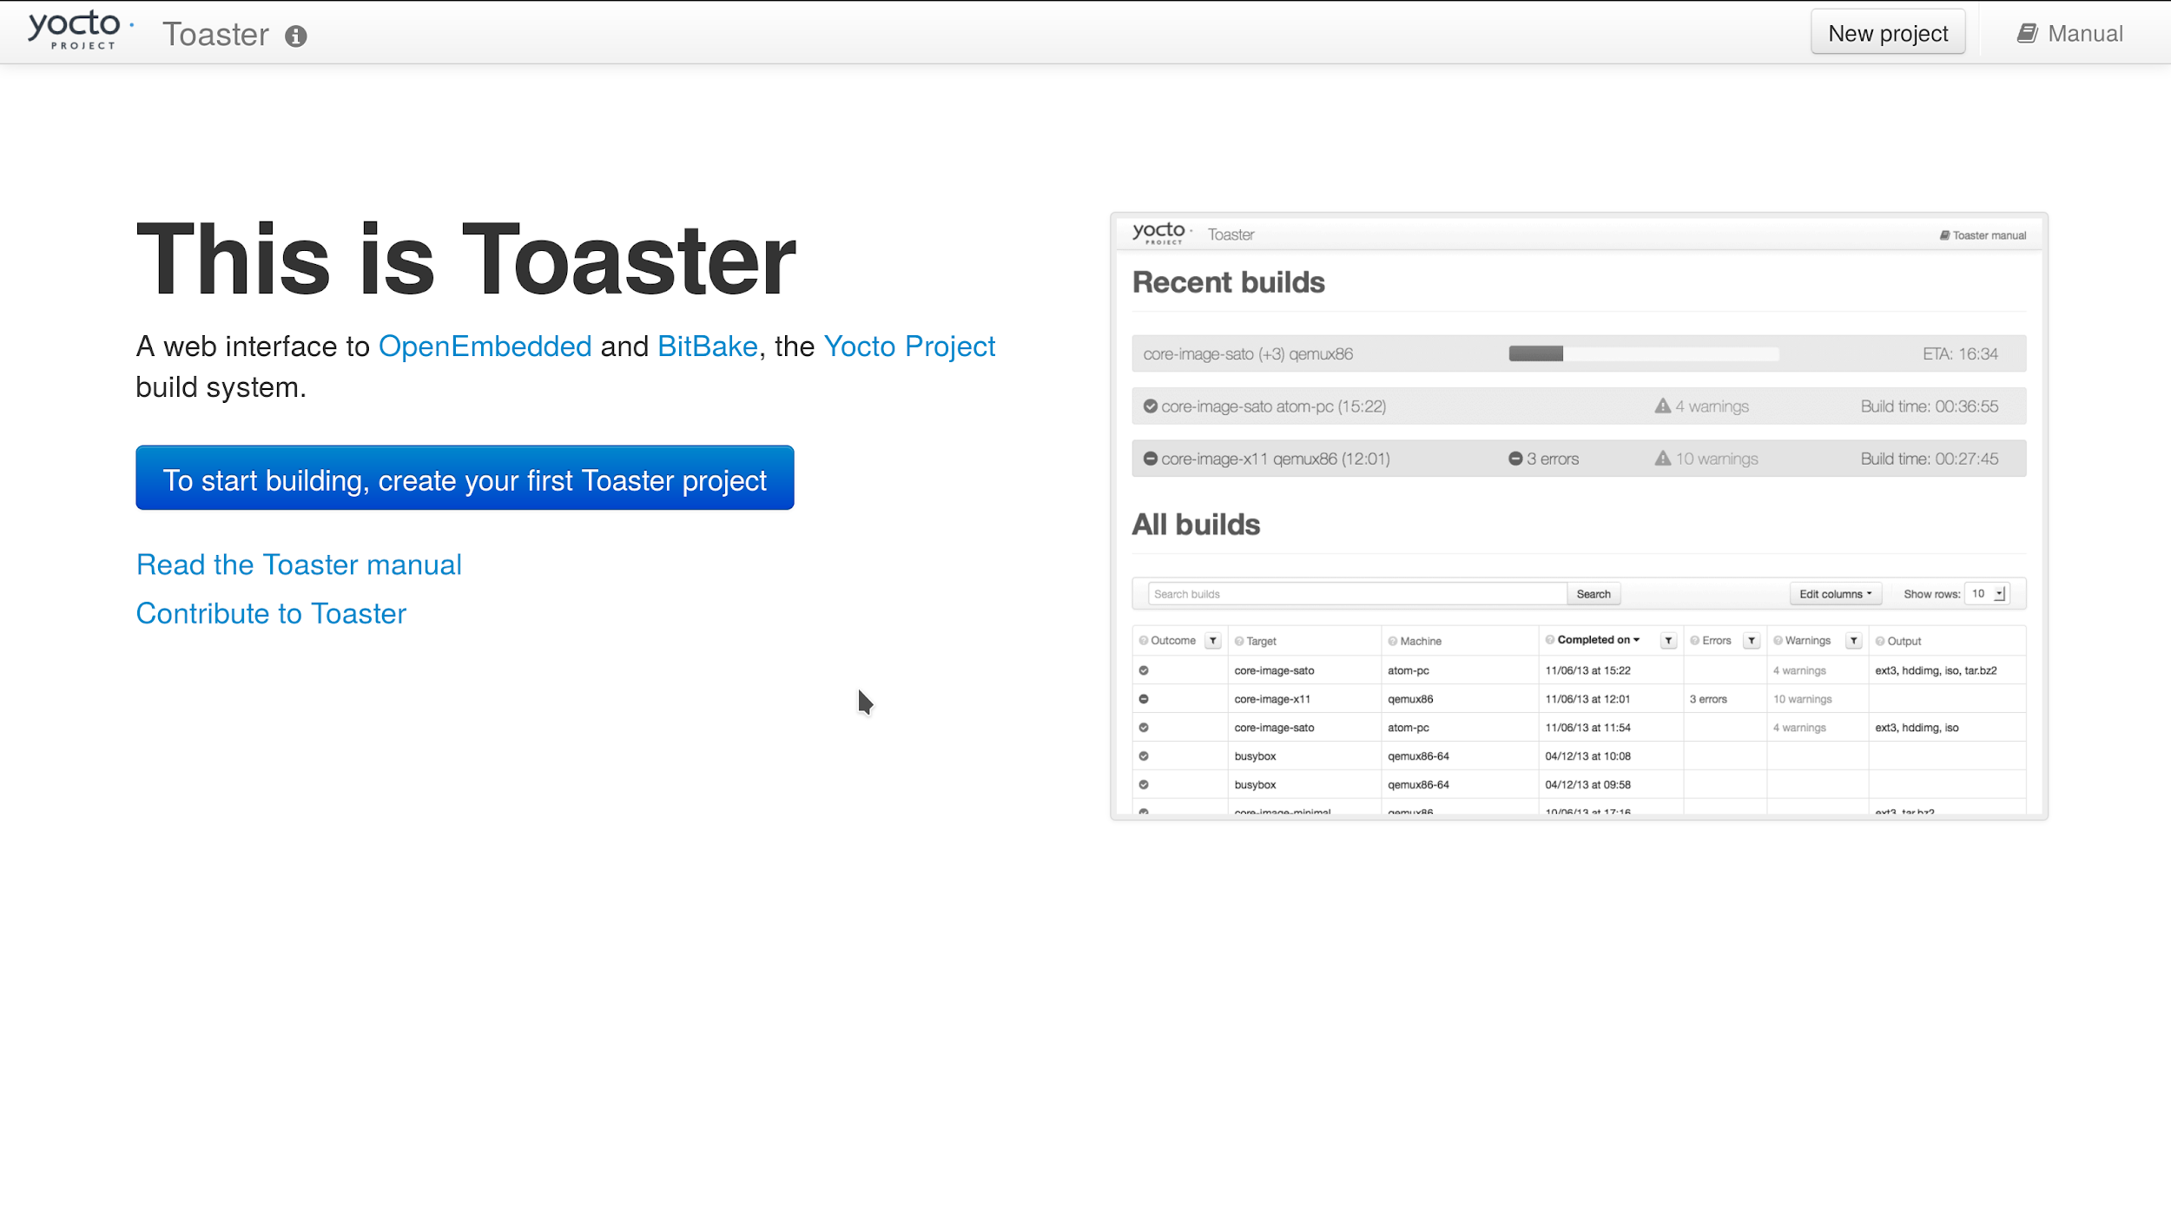
TODO Toaster
‹#›

Slide 95
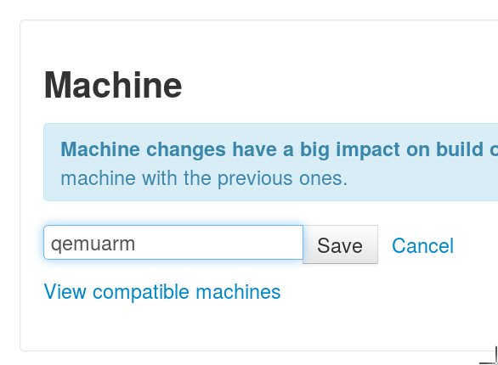
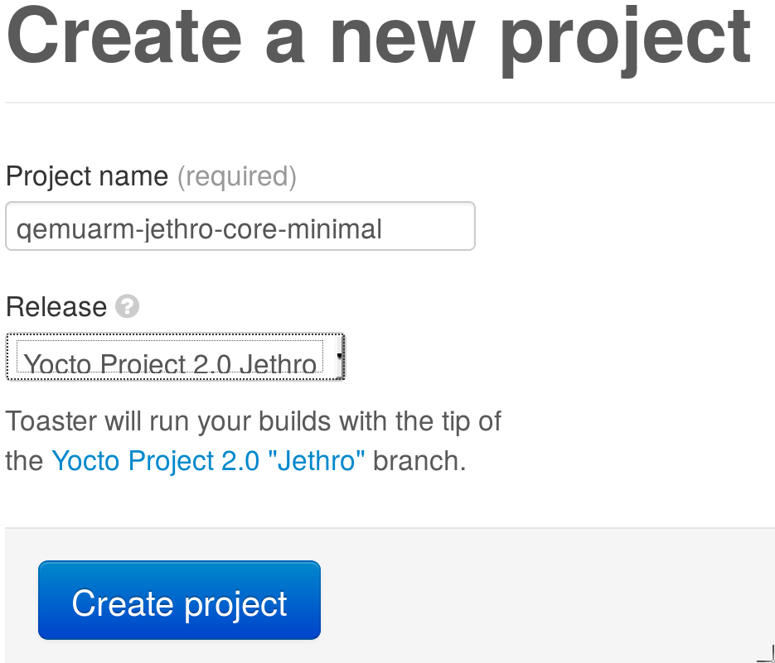
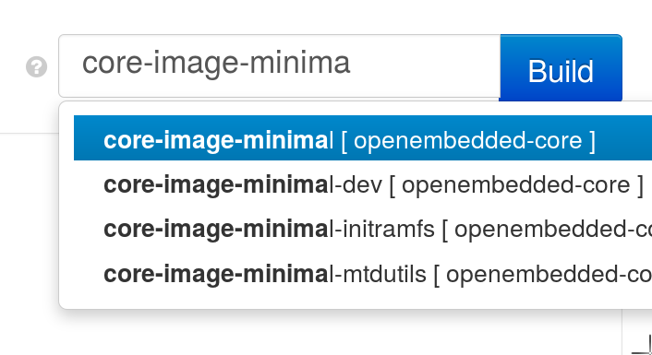
Create new build ...
1)
2)
3)
‹#›

Slide 96
Toaster demo/walkthrough
Main page
Create new project
Select Machine
Add custom layers or recipes
Build an image
Image
Image manifest
‹#›

Slide 97
BUILD AN APPLICATION
Adding a "hello world" application to our custom image
‹#›

Slide 98
Building an Application
General procedure:
Write hello world application (hello.c)
Create recipe for hello world application
Modify image recipe to add hello world application to your image
What follows is the example of a simple one C file application
(Building a more complicated recipe from a tarball would specify how to find the upstream source with the SRC_URI)
‹#›

Slide 99
Add Application Code
For a simple one C file package, you can add the hello application source to a directory called files in the hello package directory
$ mkdir -p ${HOME}/yocto/build/meta-ypdd/\
recipes-core/hello/files
$ vi /scratch/sandbox/meta-ypdd/recipes-core/\
hello/files/hello.c
‹#›

Slide 100
Application Code
$ vi /scratch/sandbox/meta-ypdd/recipes-core/hello/files/hello.c
#include <stdio.h>
int main(int argc, char **argv) {
printf("Hello World\n");
return 0;
}
‹#›

Slide 101
Add Application Recipe
Write hello world recipe
Create directory to hold the recipe and associated files
$ mkdir -p ${HOME}/yocto/build/meta-ypdd/\
recipes-core/hello
(We actually did this already in the previous step)
Create hello_1.0.bb (next slide)
$ vi ${HOME}/yocto/build/meta-ypdd/\
recipes-core/hello/hello_1.0.bb
‹#›

Slide 102
Application Recipe
$ vi ${HOME}/yocto/build/meta-ypdd/recipes-core/hello/hello_1.0.bb
DESCRIPTION = "Hello World example"
LICENSE = "MIT"
LIC_FILES_CHKSUM = "file://${COREBASE}/meta/COPYING.MIT;md5=3da9cfbcb788c80a0384361b4de20420"
S = "${WORKDIR}"
SRC_URI = "file://hello.c"
do_compile() {
${CC} ${CFLAGS} ${LDFLAGS} hello.c -o hello
}
do_install() {
install -d -m 0755 ${D}/${bindir}
install -m 0755 hello ${D}/${bindir}/hello
}
‹#›

Slide 103
Add Application to the Image
Modify image recipe to add hello world application to your image
See example on next slide
‹#›

Slide 104
Add hello to Image
$ vi ${HOME}/yocto/build/meta-ypdd/recipes-core/images/ypdd-image.bb
DESCRIPTION = "A core image for YPDD"
LICENSE = "MIT"
# Core files for basic console boot
IMAGE_INSTALL = "packagegroup-core-boot"
# Add our desired extra files
IMAGE_INSTALL += "psplash dropbear hello"
inherit core-image
IMAGE_ROOTFS_SIZE ?= "8192"
Add the package 'hello' to your image recipe
‹#›

Slide 105
Build and Test Application
Now (re)build your image recipe
$ bitbake ypdd-image
hello_1.0.bb will be processed because it is in your custom layer, and referenced in your image recipe.
Boot your image using runqemu, as before:
$ runqemu qemuarm tmp/deploy/images/\
qemuarm/ypdd-image-qemuarm.ext4 nographic
You should be able to type "hello" at the command line and see "Hello World"
‹#›

Slide 106
It’s not an Embedded
Linux Distribution
It Creates a
Custom One For You
‹#›

Slide 107
Embedded Linux Development with Yocto Project
Training from The Linux Foundation
Want to learn how to use Yocto Project like a Pro?
https://training.linuxfoundation.org/
Embedded Linux Platform Development with Yocto Project
http://bit.ly/eldyocto
(Attendees today get a 20% discount off the yocto course)
Embedded Linux Development
http://bit.ly/eldypdd16

Slide 108
TIPS HINTS AND OTHER RESOURCES
The following slides contain reference material that will help you climb the Yocto Project learning curve
‹#›

Slide 109
Common Gotchas When Getting Started
Working behind a network proxy? Please follow this guide:
https://wiki.yoctoproject.org/wiki/Working_Behind_a_Network_Proxy
Do not try to re-use the same shell environment when moving between copies of the build system
oe-init-build-env script appends to your $PATH, it's results are cumulative and can cause unpredictable build errors
Do not try to share sstate-cache between hosts running different Linux distros even if they say it works
‹#›

Slide 110
Project Resources
The Yocto Project is an open source project, and aims to deliver an open standard for the embedded Linux community and industry
Development is done in the open through public mailing lists: openembedded-core@lists.openembedded.org, poky@yoctoproject.org, and yocto@yoctoproject.org
And public code repositories:
http://git.yoctoproject.org and
http://git.openembedded.org
Bug reports and feature requests
http://bugzilla.yoctoproject.org
‹#›

Slide 111
Tip: ack-grep
Much faster than grep for the relevant use cases
Designed for code search
Searches only relevant files
Knows about many types: C, asm, perl
By default, skips .git, .svn, etc.
Can be taught arbitrary types
Perfect for searching metadata
‹#›

Slide 112
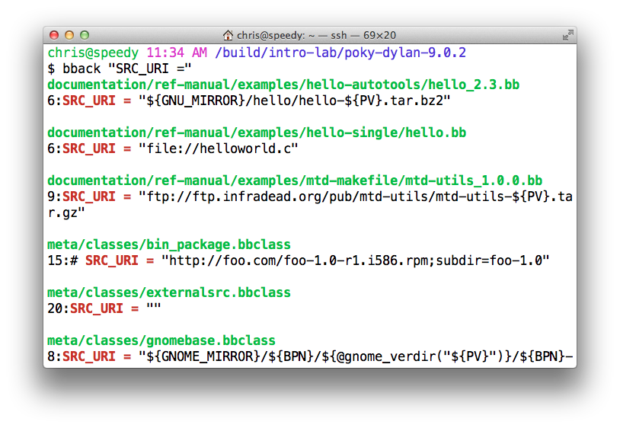
Tip: ack-grep
alias bback='ack-grep --type bitbake'
‹#›

Slide 113
TIP: VIM Syntax Highlighting
https://github.com/openembedded/bitbake/tree/master/contrib/vim
Install files from the above repo in ~/.vim/
Add "syntax on" in ~/.vimrc
$ tree ~/.vim/
/Users/chris/.vim/
├── ftdetect
│ └── bitbake.vim
├── ftplugin
│ └── bitbake.vim
├── plugin
│ └── newbb.vim
└── syntax
└── bitbake.vim
‹#›

Slide 114
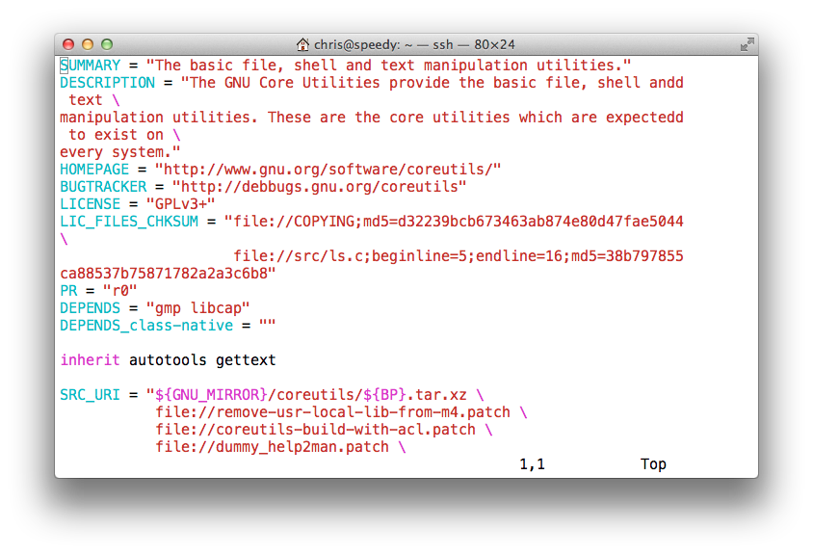
TIP: VIM Syntax Highlighting
‹#›

Slide 115
Demo: yocto for the
dragonboard 410c
The following section introduces the dragonboard as example hardware. Beaglebone and Minnow are supported in a similar manner.
‹#›

Slide 116
dragonboard in one Slide
The dragonboard uses a 3rd-party repository.
Download repo tool:
$ mkdir -p ${HOME}/bin $ curl https://storage.googleapis.com/git-repo-downloads/repo > ${HOME}/bin/repo $ chmod a+x ${HOME}/bin/repo $ export PATH=${HOME}/bin:${PATH}
Download the repositories with repo:
$ mkdir oe-qcom && cd oe-qcom $ repo init -u https://github.com/96boards/oe-rpb-manifest.git -b jethro $ repo sync $ source setup-environment # SELECT the dragonboard
Build the image:
$ bitbake core-image-minimal
Profit!!! (well… actually there is more work to do...)
‹#›

Slide 117
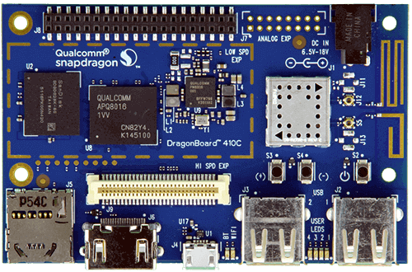
the dragonboard
Power connector
Low Speed Expansion
(attach usb-serial daughterboard here)
SD-Card slot
fastboot switch during power-on
micro-usb (fastboot)
‹#›

Slide 118
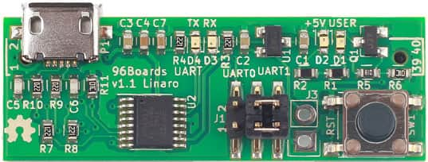
serial port options
96Boards UART Serial Adapter
http://linaro.co/uart-seeed
ships from china (seeed)
1.8V (!!) serial cable (can be hard to get)
e.g. FTDI TTL-232RG-VREG1V8
e.g. http://usb2serialcables.com/
Level converter + usual 3.3V or 5V usb-serial cable
SparkFun Voltage-Level Translator Breakout - TXB0104
‹#›

Slide 119
eMMC installation
See: https://github.com/96boards/documentation/wiki/Dragonboard-410c-OpenEmbedded-and-Yocto
Install ‘fastboot’ (apt-get install android-tools-fastboot) & put board in fastboot mode
Download bootloader package: http://builds.96boards.org/releases/dragonboard410c/linaro/rescue/latest/dragonboard410c_bootloader_emmc_linux-46.zip
Unzip, then call ./flashall inside the folder. This will wipe (!) the emmc and deploy a new partition layout and bootloader files.
Flash the build results from tmp-eglibc/deploy/images/dragonboard-410c:
$ cd tmp-eglibc/deploy/images/dragonboard-410c
$ [gunzip image-dragonboard-410c.ext4.gz] $ fastboot flash rootfs core-image-minimal-dragonboard-410c.ext4 $ fastboot flash boot boot-dragonboard-410c.img
‹#›

Slide 120
SD-card installation (I)
See: https://github.com/96boards/documentation/wiki/Dragonboard-410c-GPT (new. use at own risk)
Recompile the patched bootloader:
# get compiler git clone --depth 1 \ git://codeaurora.org/platform/prebuilts/gcc/linux-x86/arm/arm-eabi-4.8.git \ -b LA.BR.1.1.3.c4-01000-8x16.0 lk_gcc # get LK source code git clone --depth 1 \ https://git.linaro.org/landing-teams/working/qualcomm/lk.git \ -b release/LA.BR.1.1.2-02210-8x16.0+sdboot lk_sdboot # build bootloader cd lk_sdboot make msm8916 EMMC_BOOT=1 TOOLCHAIN_PREFIX="`pwd`/../lk_gcc/bin/arm-eabi-" cd -
‹#›

Slide 121
SD-card installation (II)
Download the proprietary bootloader https://developer.qualcomm.com/hardware/dragonboard-410c/tools e.g.: https://developer.qualcomm.com/download/db410c/linux-board-support-package-v1.2.zip
Create the SD-card (partition layout and bootloader) git clone https://git.linaro.org/people/nicolas.dechesne/db-boot-tools.git cd db-boot-tools sudo ./mksdcard.sh -o /dev/sdX -p dragonboard410c/linux.txt \ -i ../lk_sdboot/build-msm8916/ \ -i <path to QCOM firmware files>/bootloaders-ubuntu/
Change boot arguments to use the SD-card instead of eMMC: abootimg -u boot-XXX.img -c \ "cmdline=root=/dev/mmcblk1p9 rw rootwait console=ttyMSM0,115200n8"
‹#›

Slide 122
SD-card installation (III)
Write the images to the SD-card: sudo dd if=boot-XXX.img of=/dev/sdX8 sudo dd if=core-image-minimal-dragonboard-*.rootfs.ext4 of=/dev/sdX9
replace /dev/sdX with the SD-card device
If you insert the SD card into the DragonBoard 410c and set the switch S6-2 (on the back) to ON, you should now be able to boot from SD card.
‹#›

